Slide 1
Advanced Features
Dr, Rakhee Chhibber

Slide 2
Agenda
•pivot and unpivot
•Parameters and what if analysis
• Incremental refresh
• Composite models
• Using AI visuals
• Integration with Excel and other tools

Slide 3
Pivot and unpivot
Pivoting and Unpivoting are useful data transformation techniques in Power BI that help reshape data into a structure that is easier to analyze and visualise. Using these features in Power Query, you can convert rows into columns or columns into rows depending on how your data is organised and how you want to work on it.

Slide 4
Understanding Pivoting in Power BI
Pivoting in Power BI is a data transformation technique used to reorganise data by turning category values from rows into separate columns. This results in a wider, more structured table that is easier to analyze and compare.
Converts unique row-level category values into individual column headers
Summarizes corresponding data using aggregation methods such as sum, average or count
Improves data readability and supports side-by-side comparison across categories
Helps create analysis-ready tables for reports and dashboards

Slide 5
When to Use Pivoting
When categorical data is stored vertically but needs to be analyzed side by side
When building summary tables for high-level reporting
When preparing data for matrix, table or KPI visuals
When reducing repetitive rows to create a compact and interpretable dataset

Slide 6
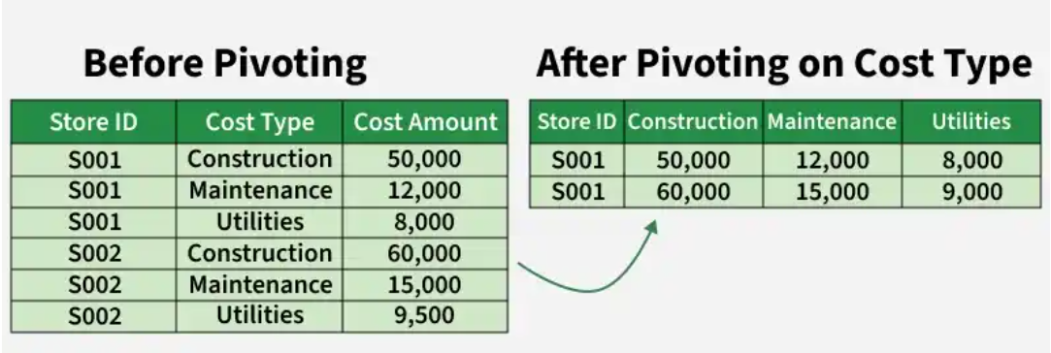
Example
Imagine a table where each row contains:
Store ID
Cost Type (Construction, Maintenance, Utilities)
Cost Amount

Slide 7
Understanding Unpivoting in Power BI
Unpivoting is the reverse of pivoting. It converts multiple columns into rows, creating a more normalized dataset. It moves values from multiple related columns into rows, making the dataset more flexible, consistent and easier to analyze.

Slide 8
When to Use Unpivoting
Unpivoting is especially useful in the following situations:
When working with wide datasets that are difficult to analyze or scale
When preparing data for charts, slicers and DAX calculations
When applying uniform calculations or filters across similar categories

Slide 9
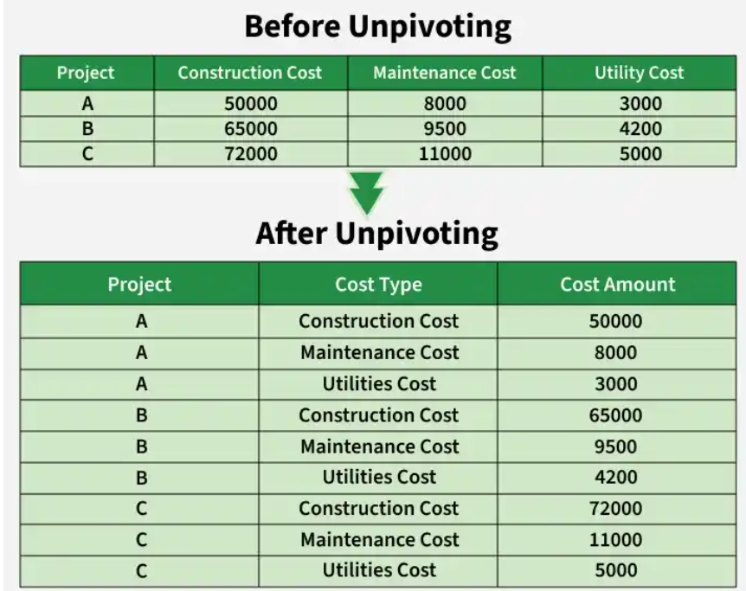
Example
Consider a dataset that contains separate columns such as Construction Cost, Maintenance Cost and Utility Cost. While this wide structure may look organized, it limits flexibility when filtering or visualizing data. By unpivoting these cost columns, Power BI transforms the dataset into:
A single Cost Type column that identifies the category
A single Cost Amount column that stores the values

Slide 10
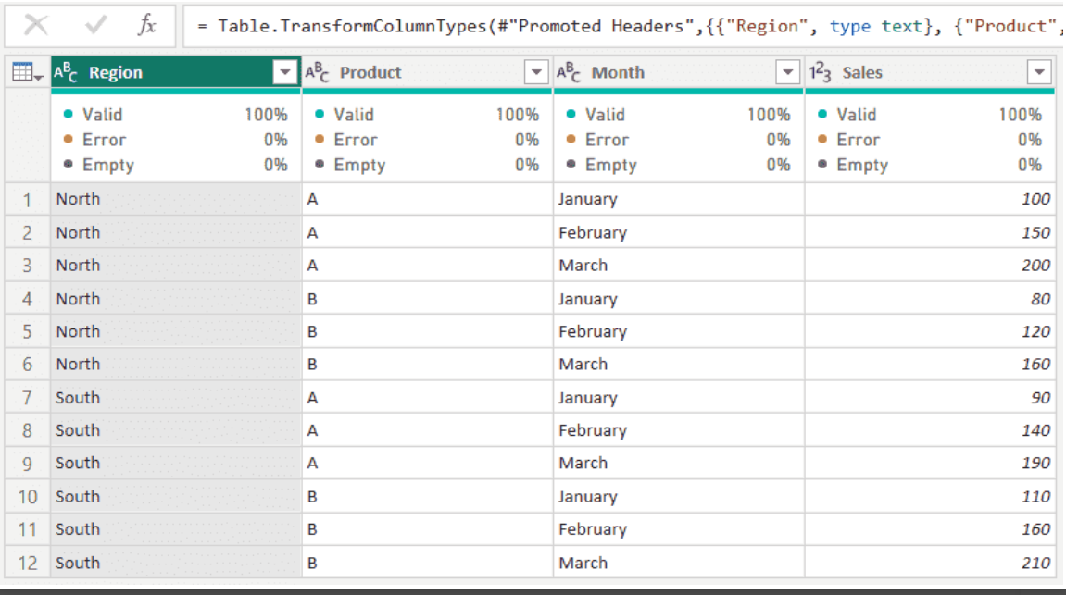
Dataset.csv

Slide 11
Steps to pivot
Open the Transform tab in the Power Query Editor.
Select the column you want to pivot (for example, Month).
Click Pivot Column and Choose Sales as the Values Column for populating the pivoted data. And
In Advanced Options, select don’t aggregate for unique values or choose an aggregation like Sum or Average as required.
Click Close and Apply to apply the transformation

Slide 12
Steps to Unpivoting Data
Load the pivoted dataset into Power BI Desktop.
Open the Power Query Editor by clicking Transform Data.
Select the columns to unpivot such as January, February and March.
Go to the Transform tab and choose Unpivot Columns.
Power BI converts the selected columns into two new columns: Month (attribute) and Sales (value).
Click Close and Apply to confirm the changes

Slide 13
Parameters and what-if Analysis
What-If analysis in Power BI allows you to create interactive scenarios by adding a "what-if parameter". Users can adjust inputs using a slider, and the report instantly recalculates and displays how those changes impact your metrics (e.g., seeing how a 10% price increase affects total revenue)

Slide 14
Steps
Load data
Create a new measure table and add → total sales measure as
Total Sales = sum(sales_data_sample[QUANTITYORDERED]) * sum(sales_data_sample[PRICEEACH])
Add a bar graph
  Set properties as X-Axis → Year and Y-Axis → total sales (measure)
Create a parameter from modeling tab

Slide 15
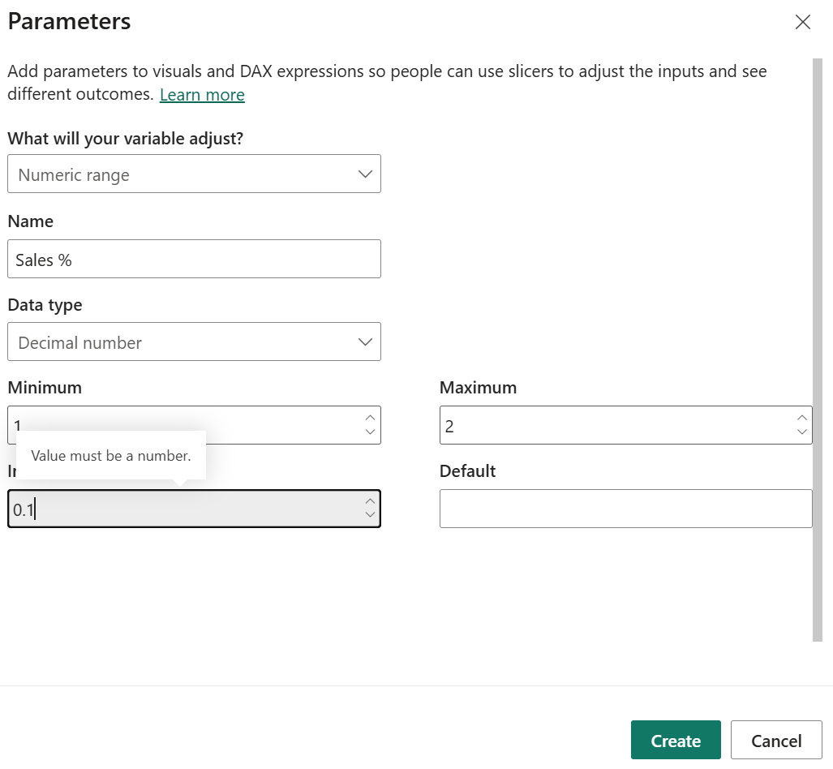
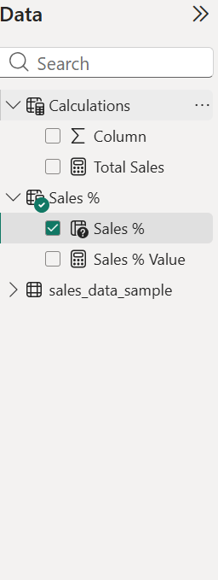

Slide 16
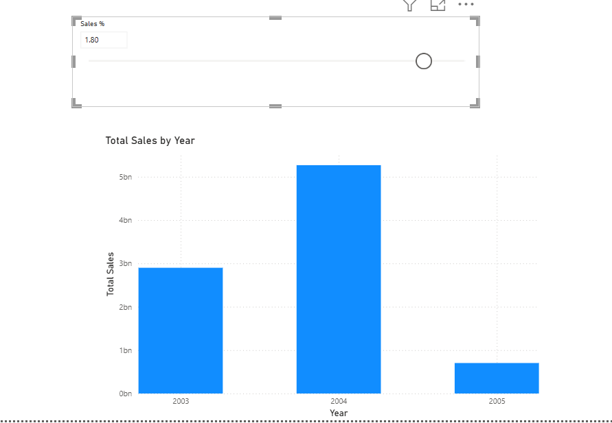

Slide 17
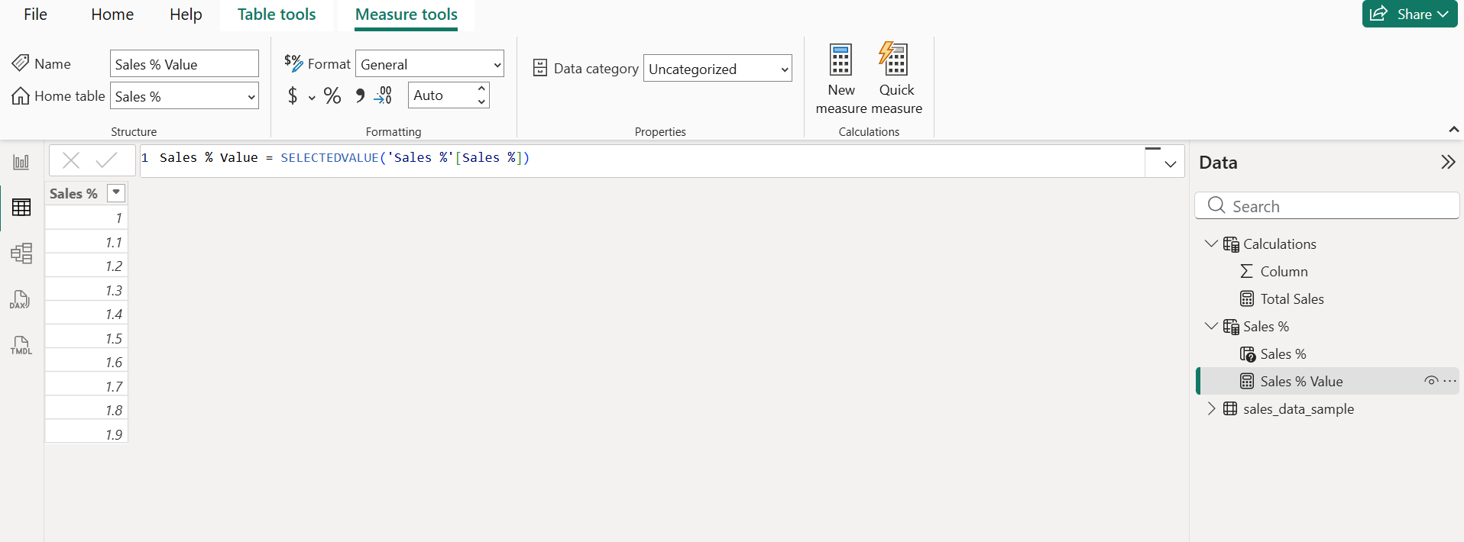

Slide 18
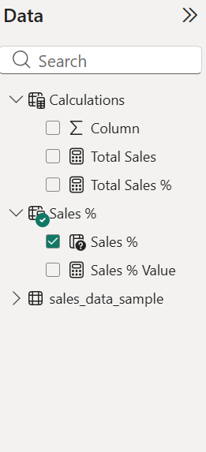
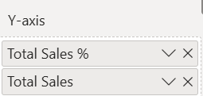
Modify the graph
Create a new measure in calculations table
Total Sales % = [Total Sales] * [Sales % Value]
Select graph and add total sales % also on Y-axis

Slide 19
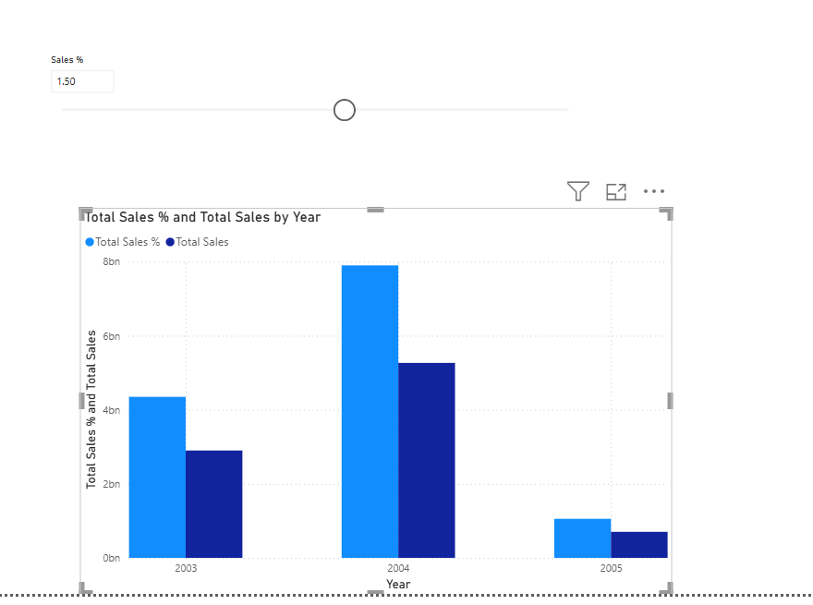

Slide 20
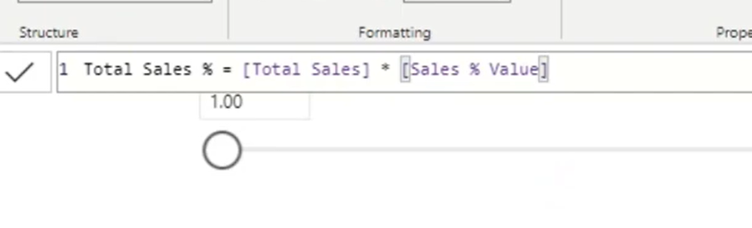

Slide 21
Incremental Refresh

Slide 22
Incremental Refresh
Should have Power BI service Account

Slide 23
Set up a free Microsoft power BI service Login

Slide 24

Set up for free power bi service
Search for dynamics 365
Try for free
Select the dynamics sales→ try for free
Give your gmail id → setup new

Slide 25


Slide 26
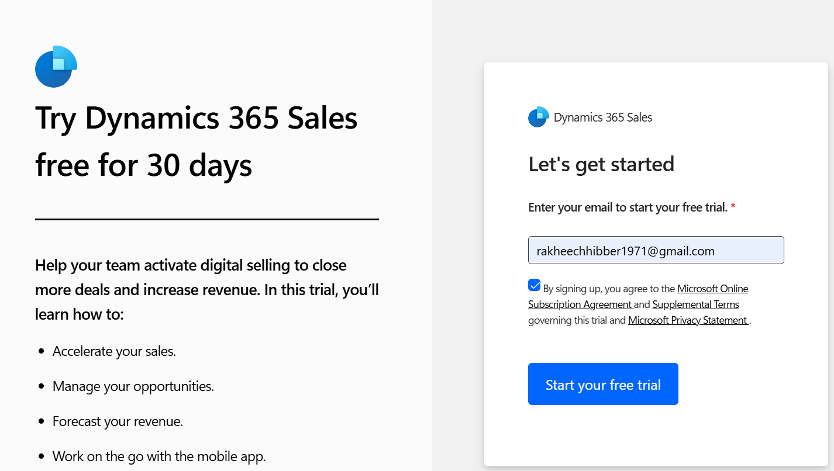

Slide 27
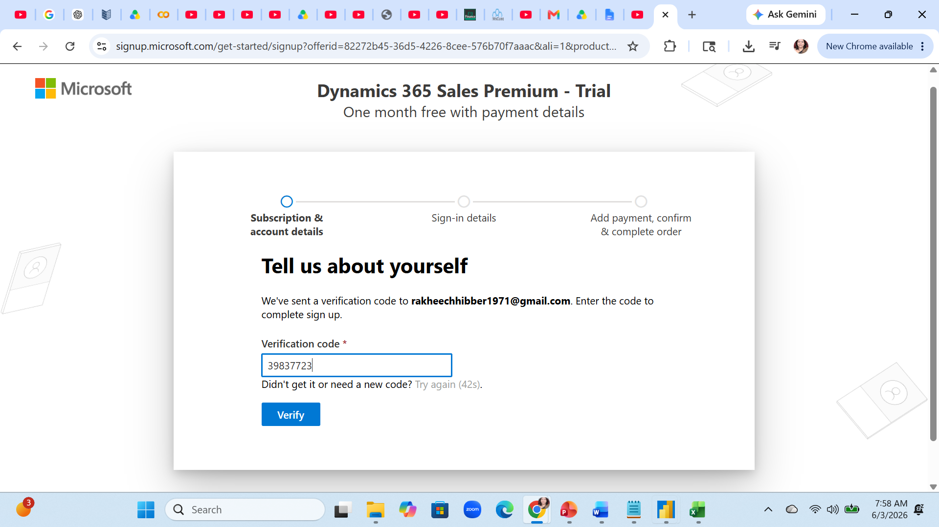

Slide 28
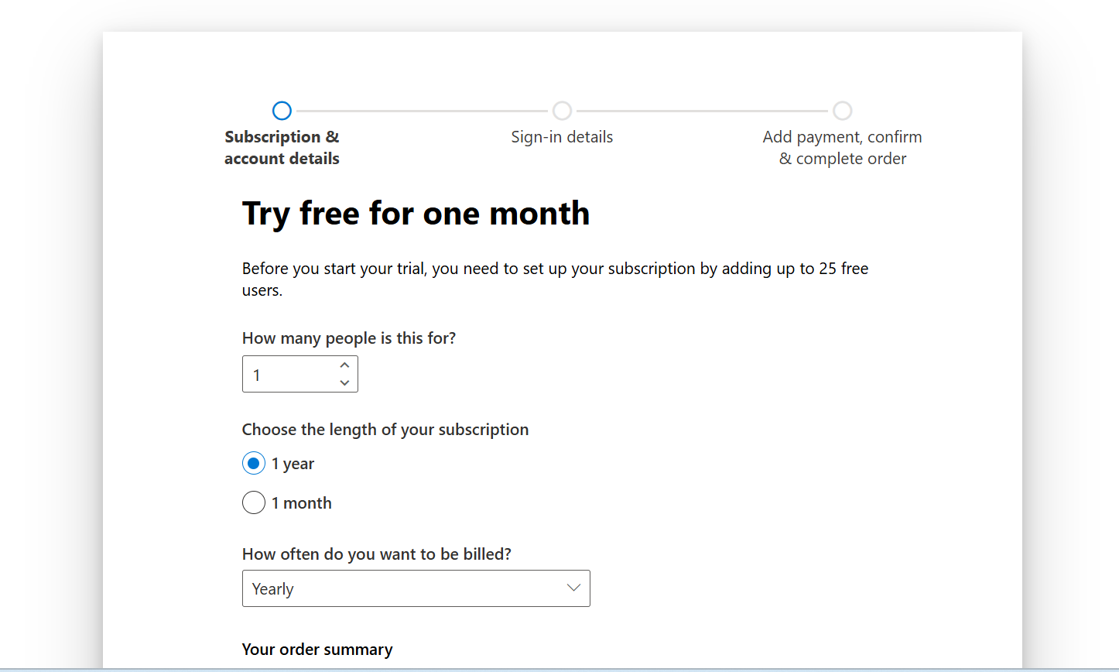

Slide 29
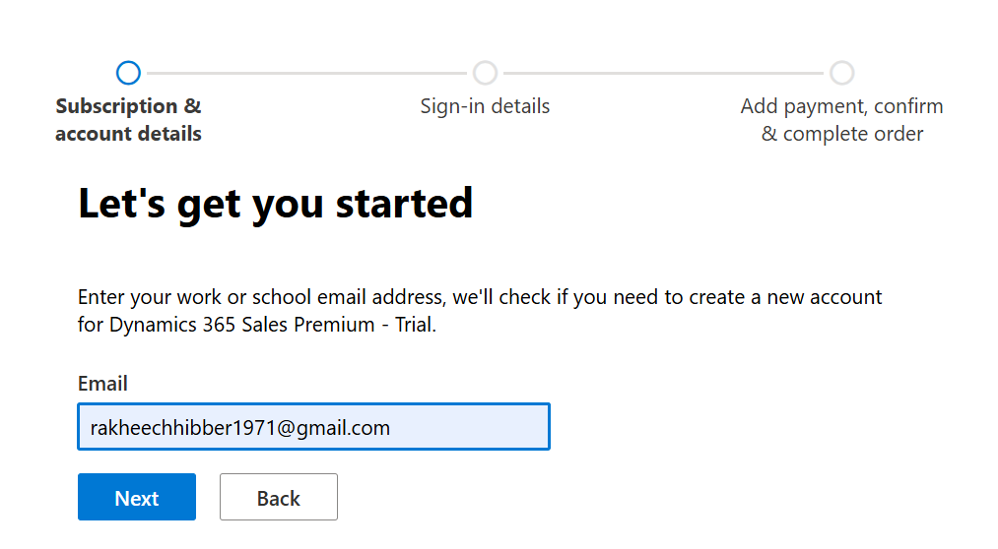

Slide 30
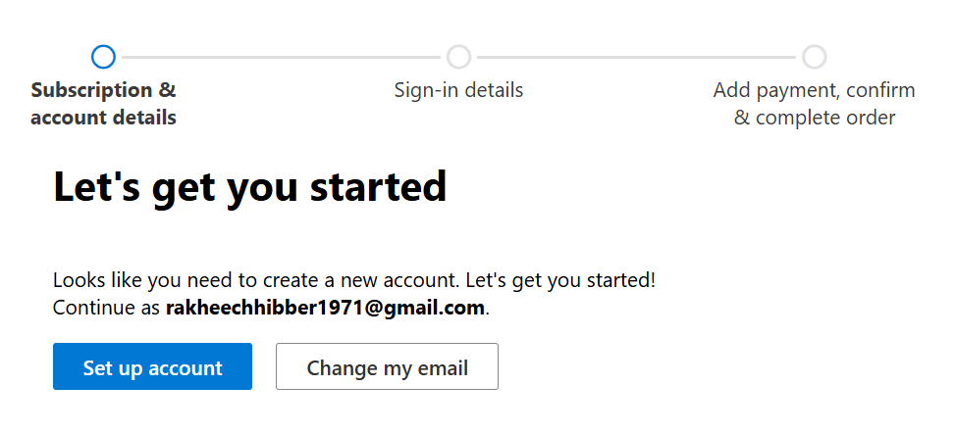

Slide 31
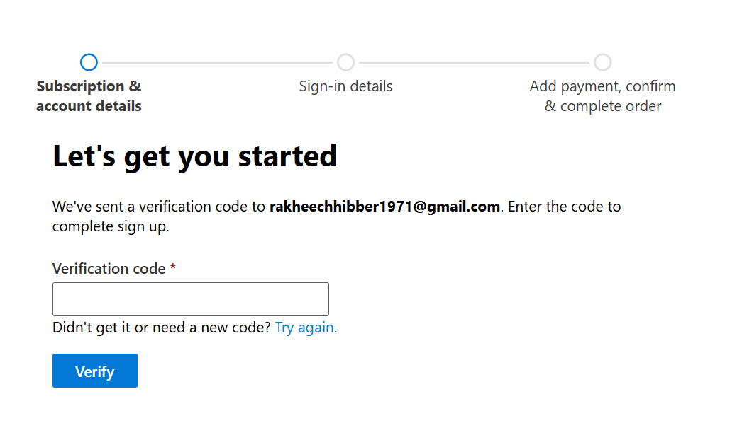

Slide 32
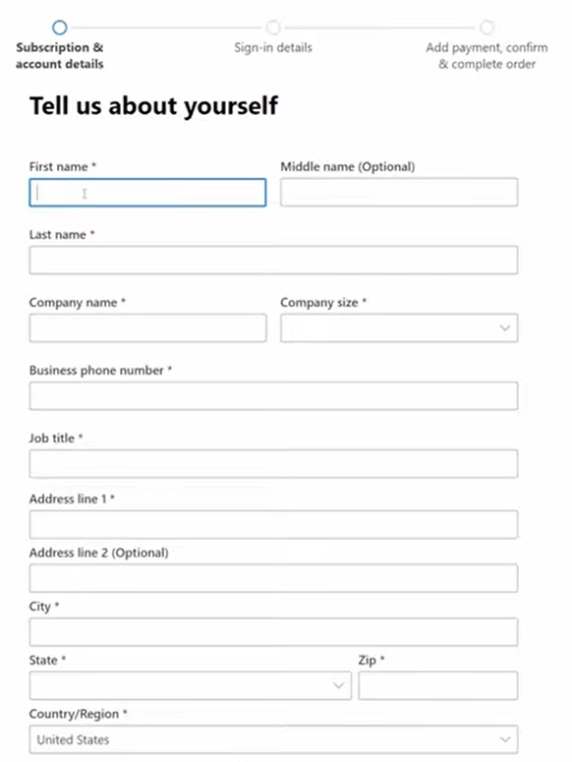

Slide 33
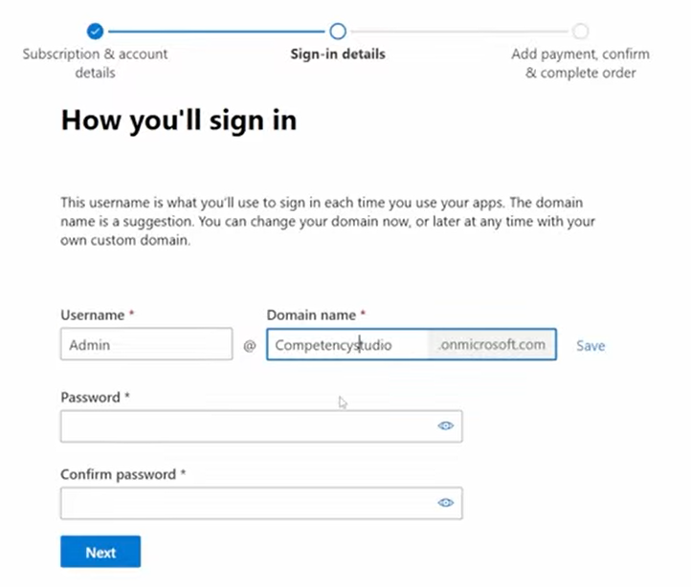

Slide 34
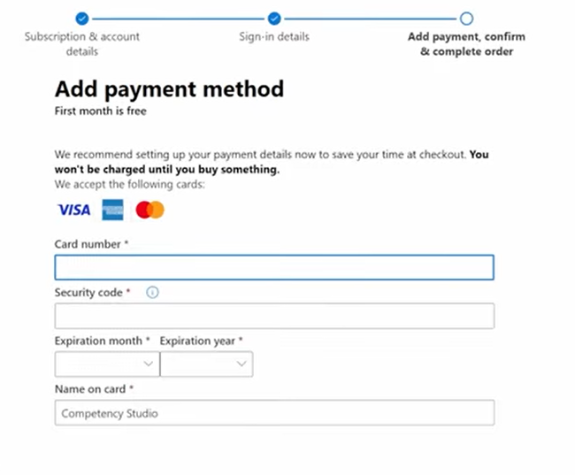

Slide 35
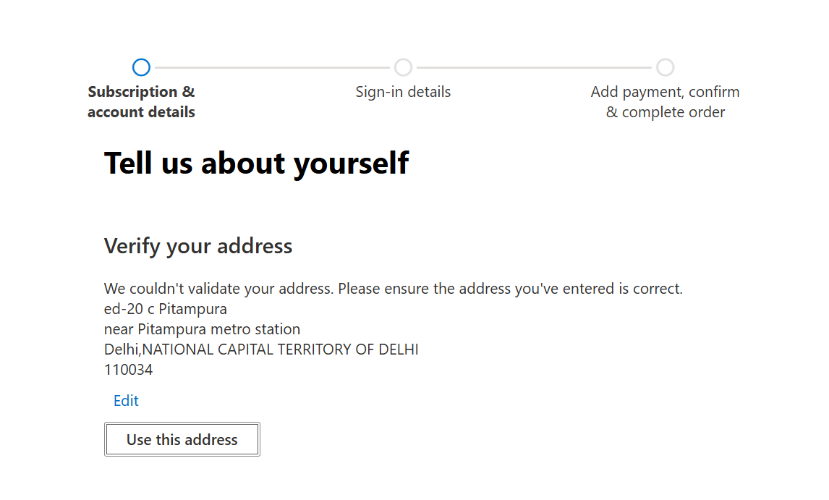

Slide 36
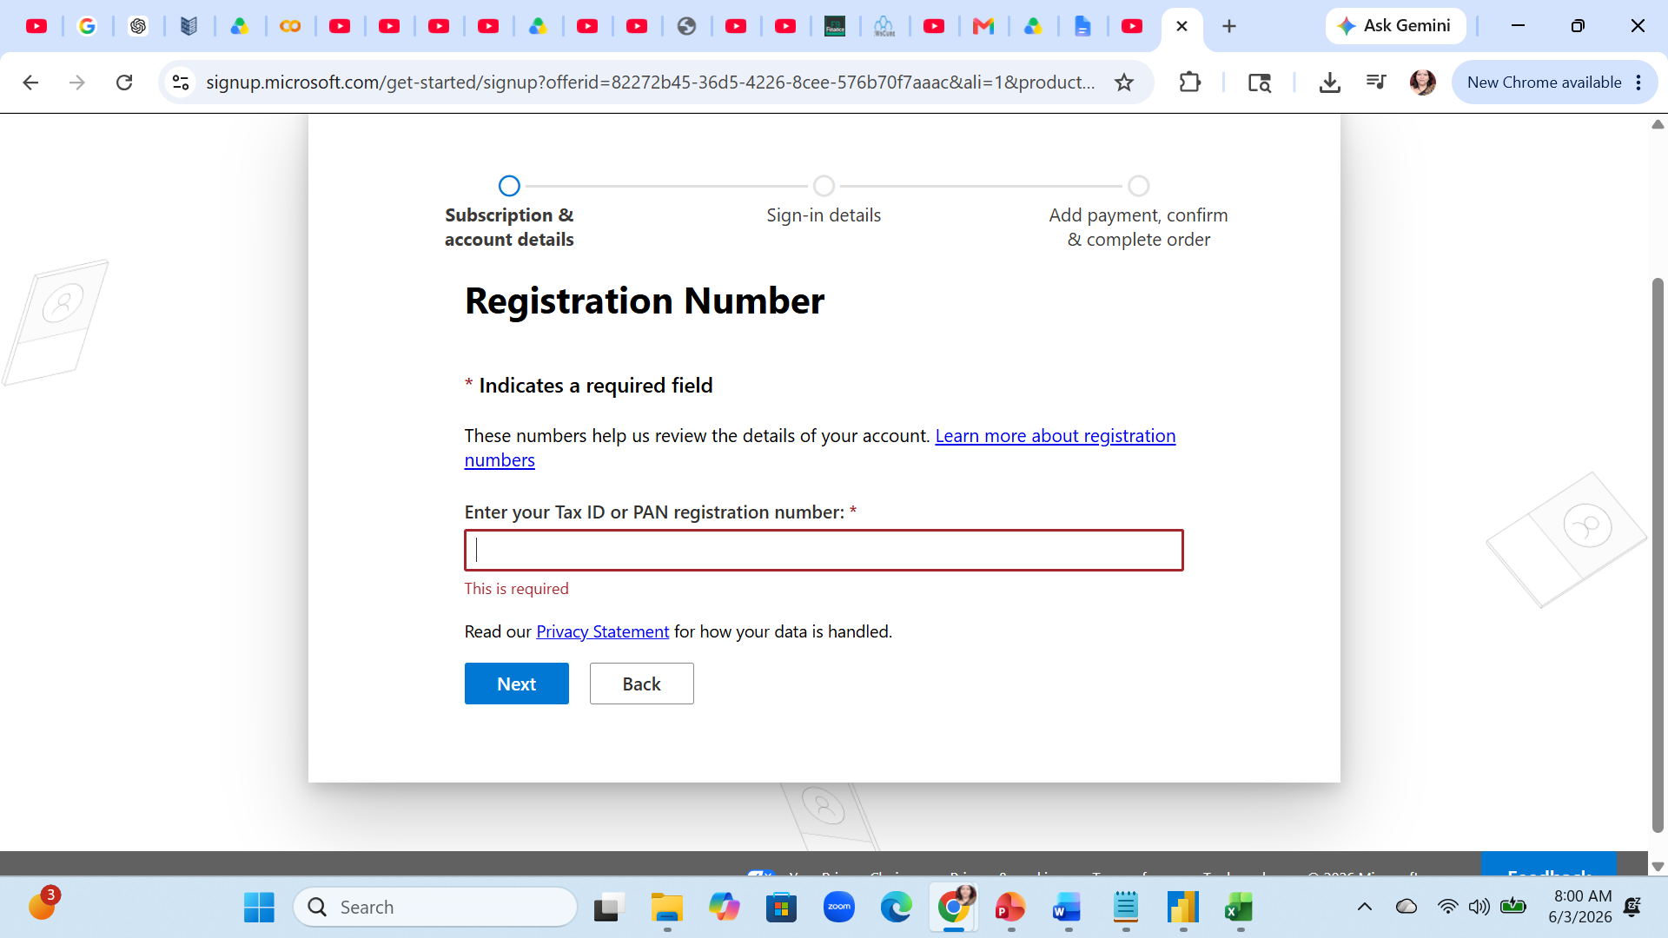

Slide 37
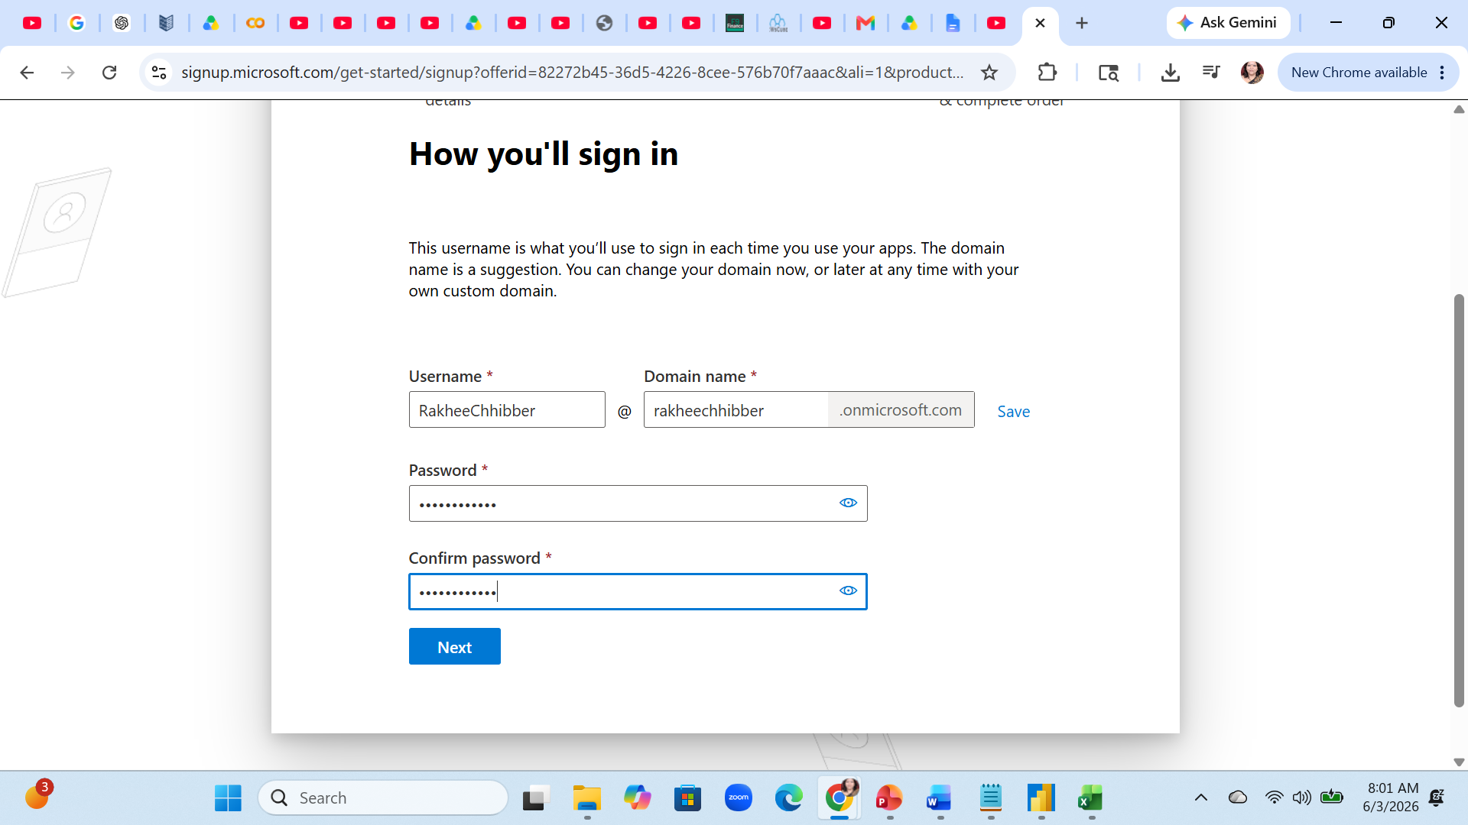

Slide 38
Incremental refresh

Slide 39

Steps
Load data
Grocery sales
Create a card
Before implementing incremental refresh we have to create some parameters

Slide 40
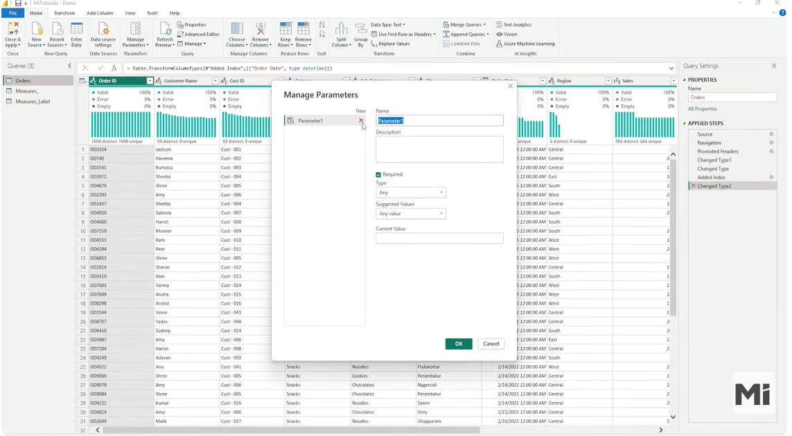

Slide 41
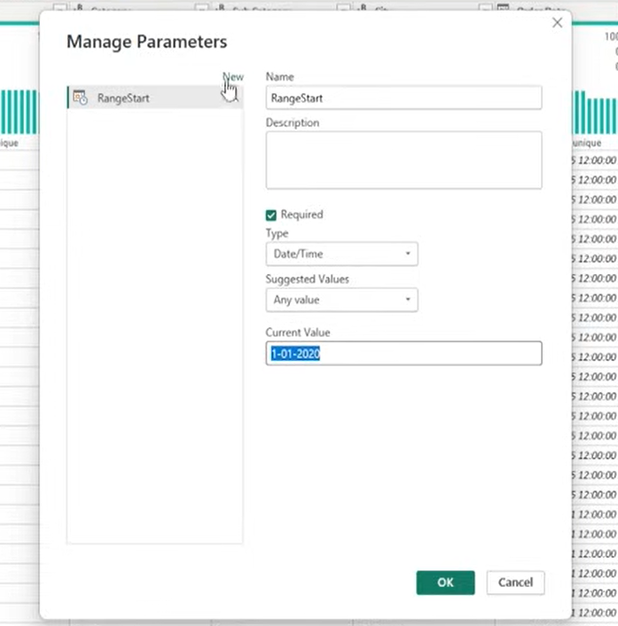
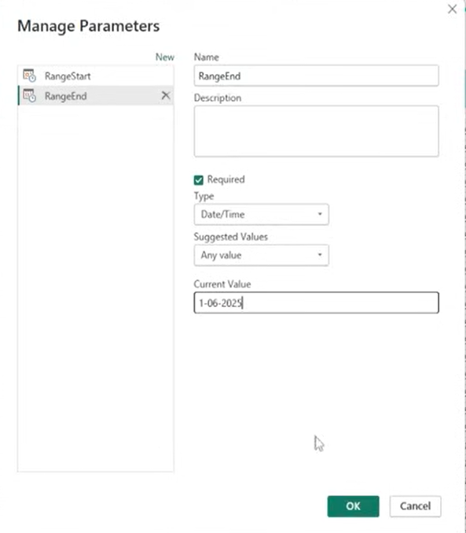

Slide 42
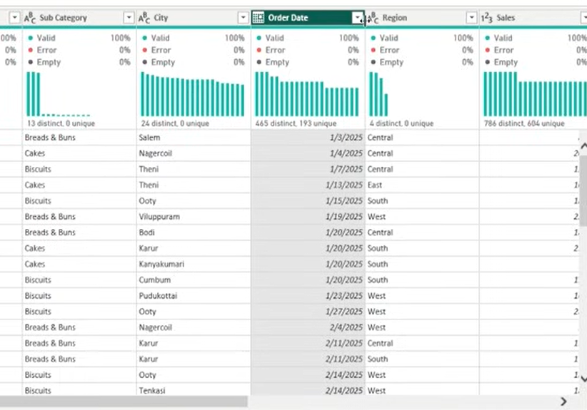
Check For the data type of OrderDate. It Should be date type – if it is not datetime type
We will not able to see the parameter selection
→ See on next slide

Slide 43
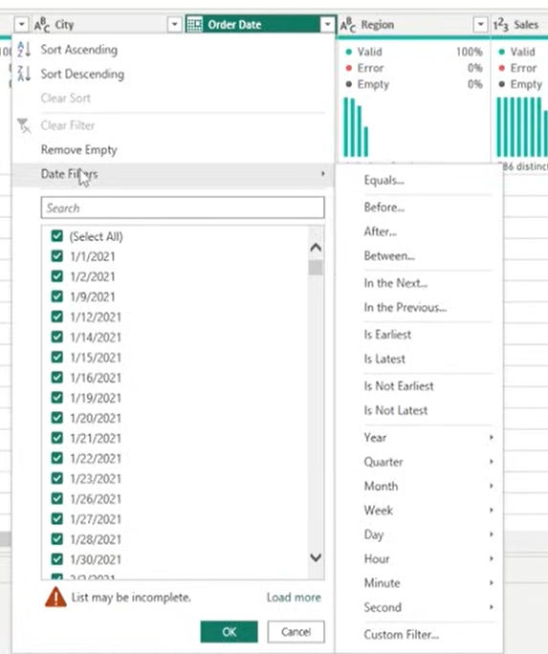
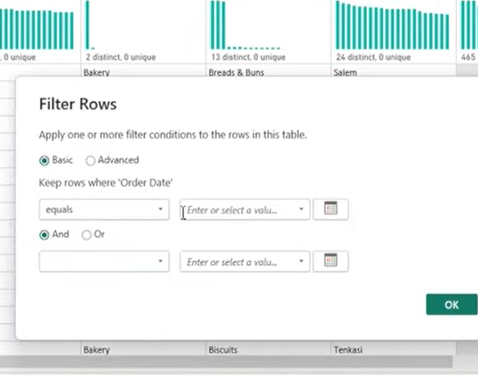
No Parameters selection option. So change the Data Type as DateTime

Slide 44
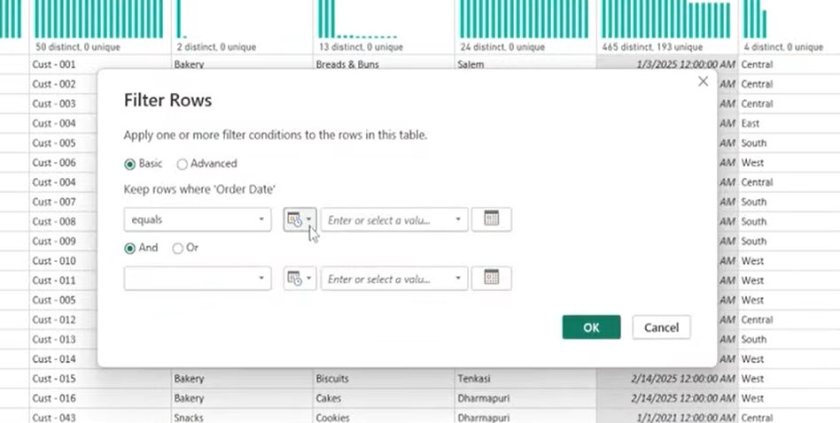
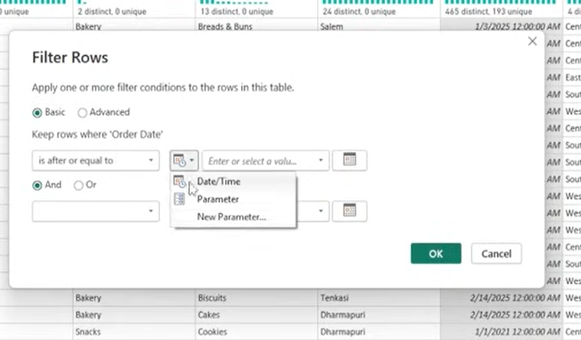

Slide 45
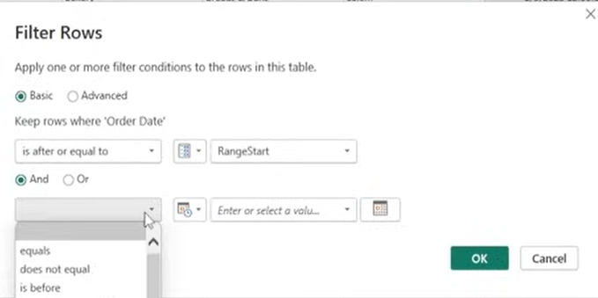
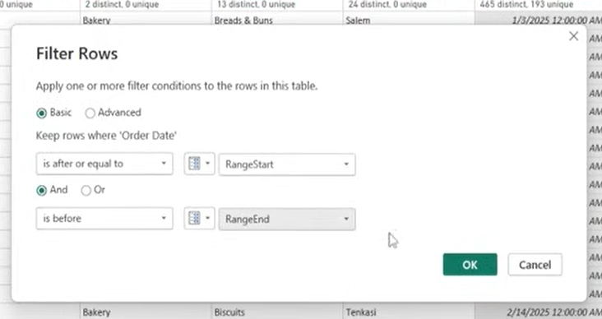

Slide 46
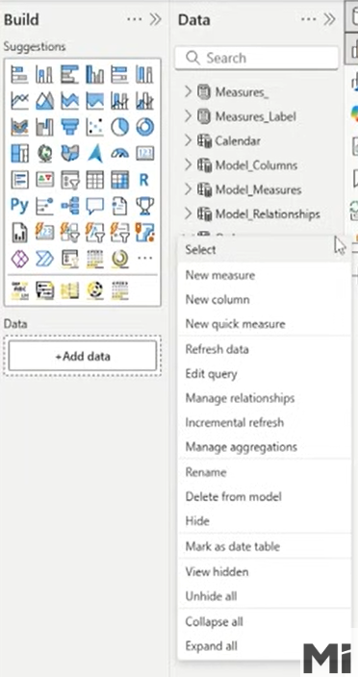
Set up the incremental refresh
Select order table → 3 dots → incremental refresh

Slide 47
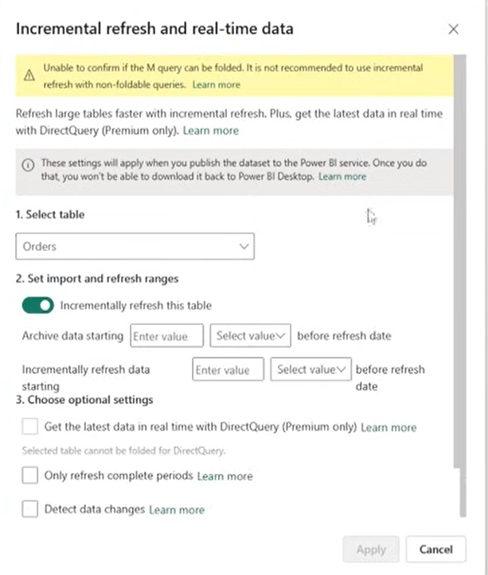
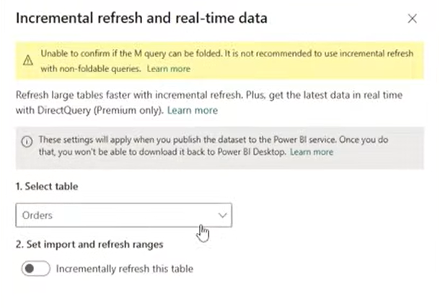
Select the incremental refresh this table button

Slide 48
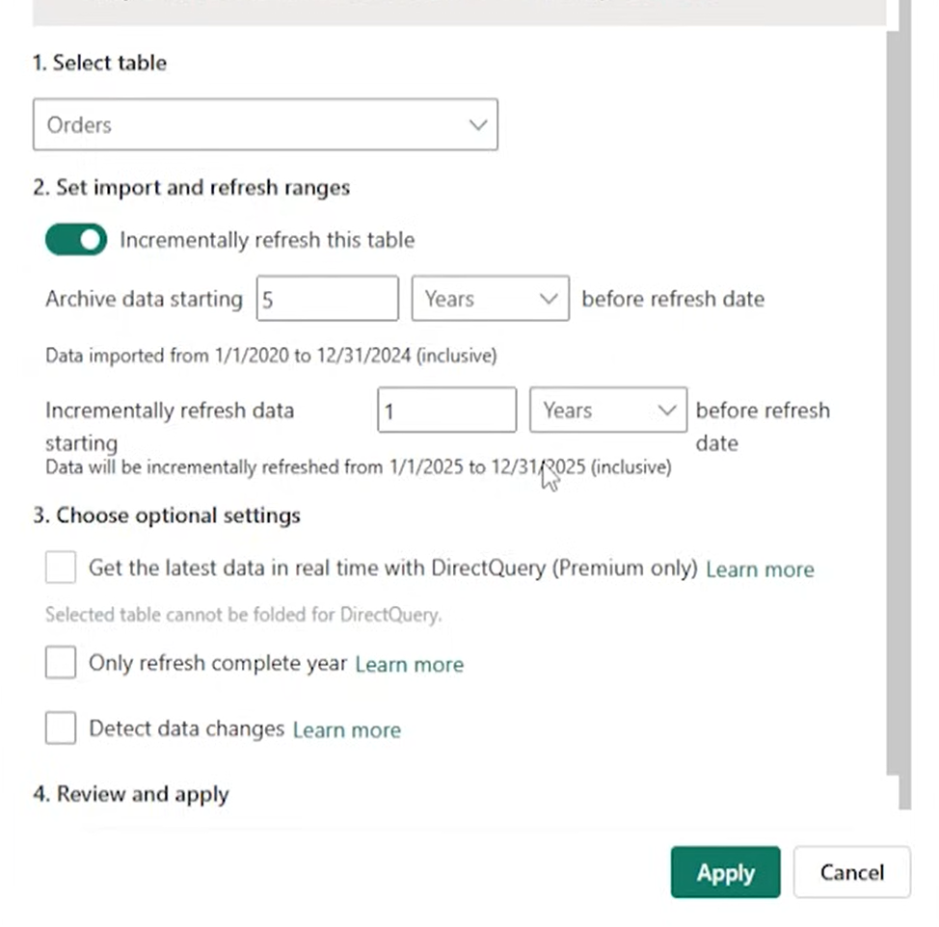
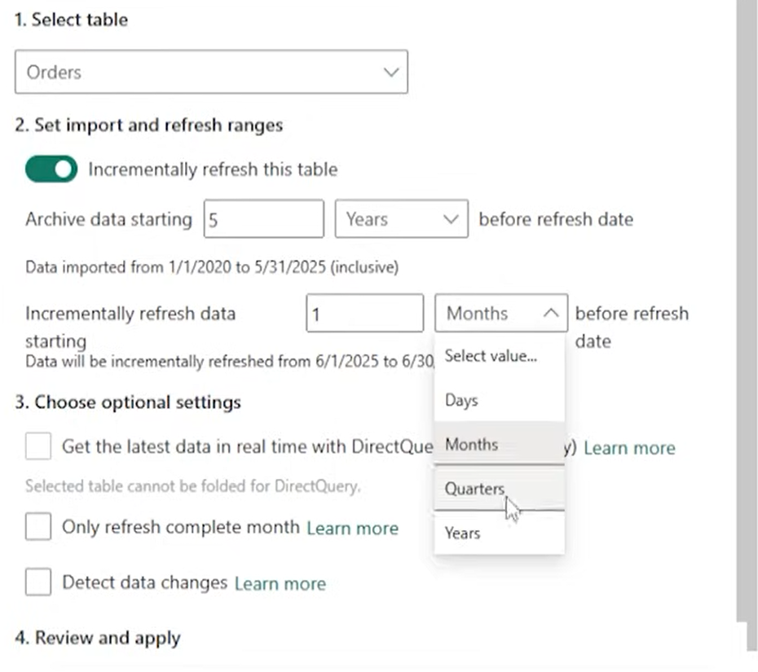

Slide 49
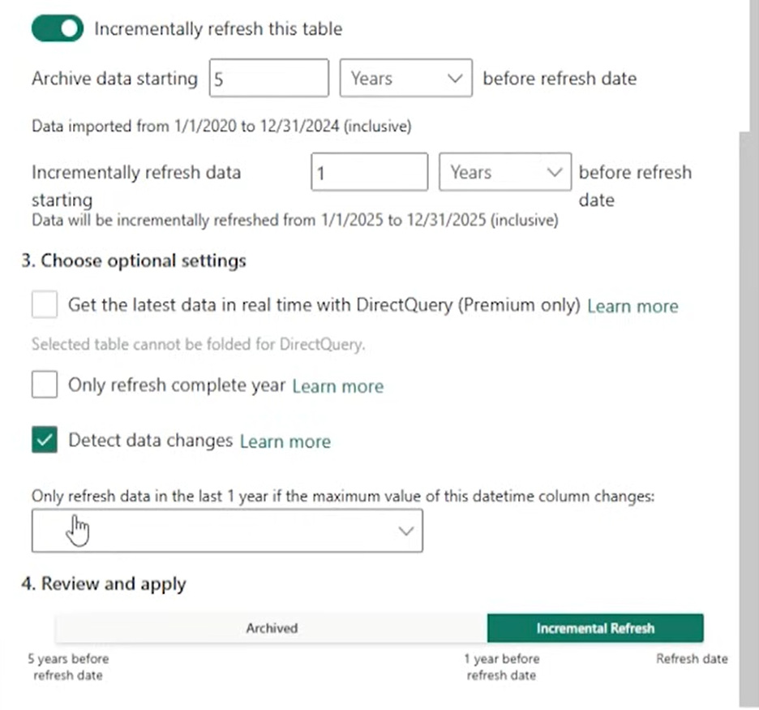

Slide 50
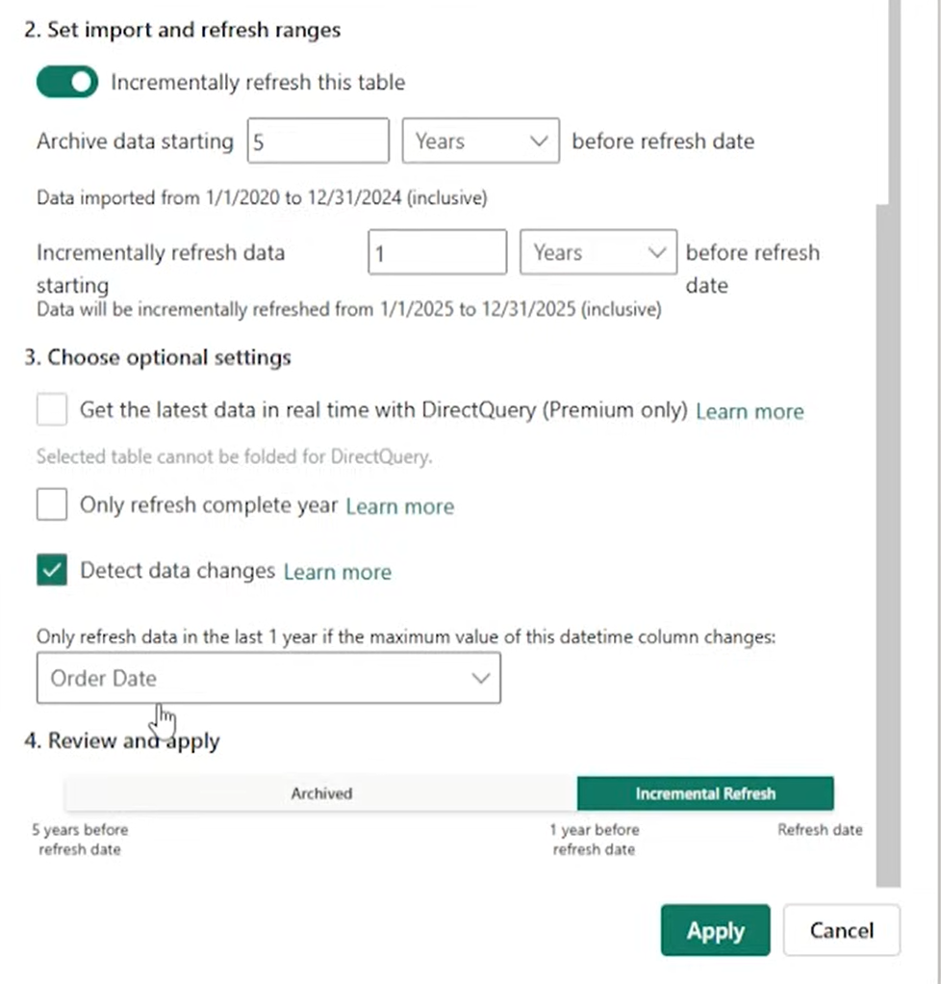

Slide 51
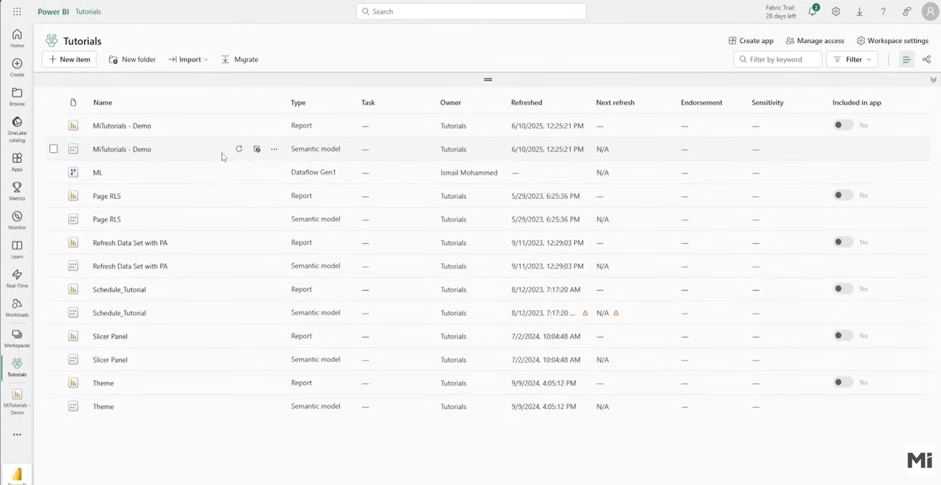

Slide 52
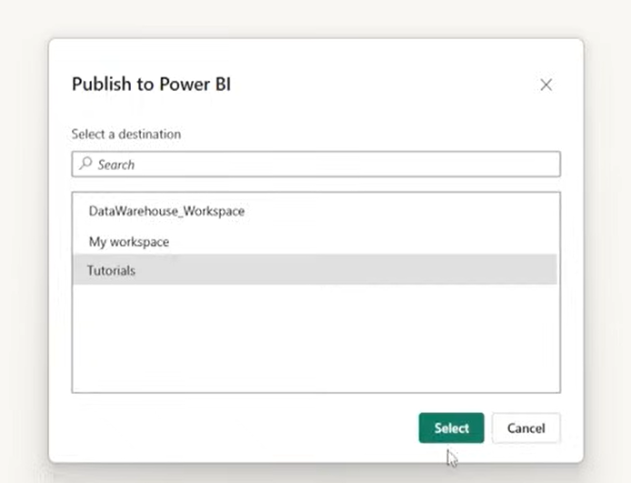

Slide 53
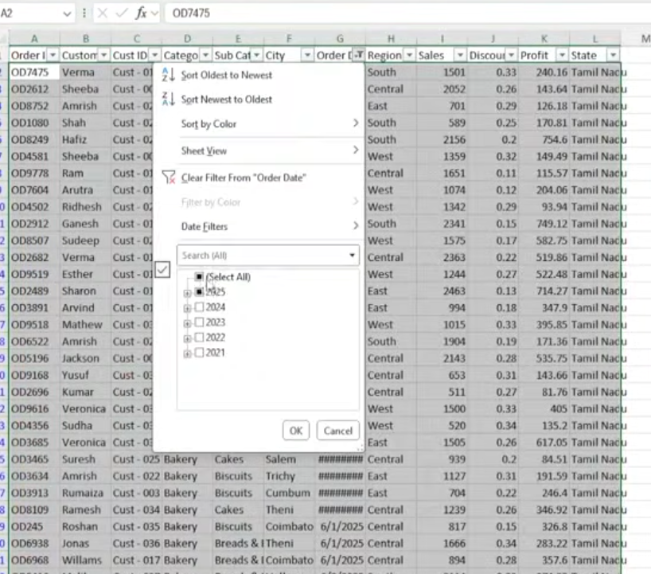
Add some date in excel sheet and refresh

Slide 54
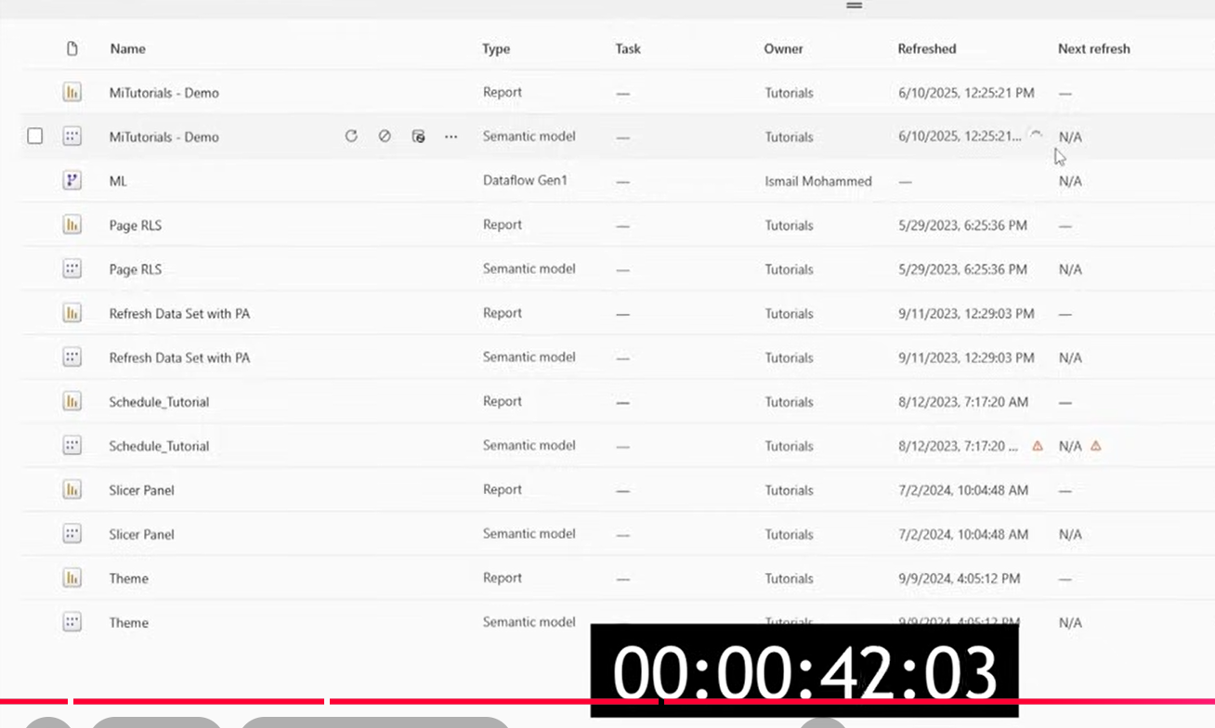

Slide 55
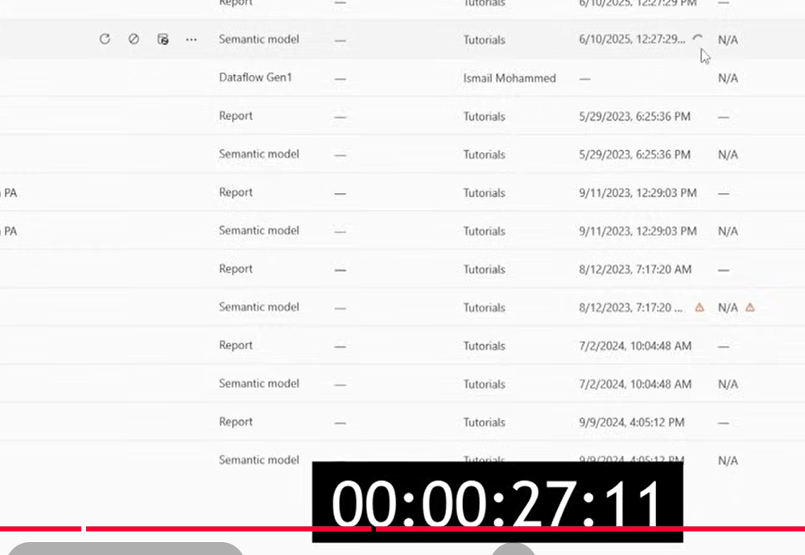

Slide 56

Incremental Refresh
Before
After

